Slide 1
DaVinci Challenge as Tool for Extended Learning
Computer Aided Design (CAD)
Additive Manufacturing
Robot Operating System (ROS)
Computer Vision
Deep Learning

Slide 2
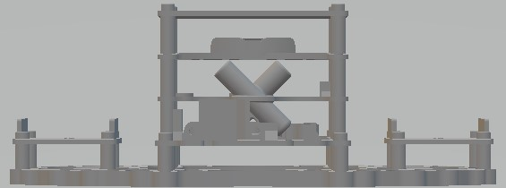
Computer Aided Design
Fixtures can be designed to hold the avionics and auxiliary sensors, computers, and actuators.

Slide 3
Additive Manufacturing
3D Printing can can be used to fabricate fixtures, protective shells, and special appendages to “professionalize” the aircraft.
Add photo of Kashmir's aircraft

Slide 4
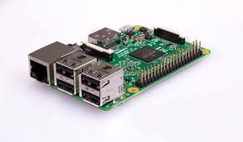
Robot Operating System
MavProxy, Mavlink-Router, ROS and other robot operating systems when installed on a companion computer such as a Raspberry Pi provide a higher degree of autonomy.

Slide 5
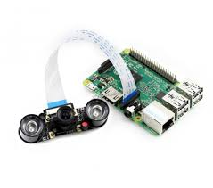
Computer Vision
With a suitable camera such as OV5647 integrated into the companion computer, and MatLab, OpenCV, or other image processing software, the aircraft can use computer vision for a higher degree of autonomy.

Slide 6
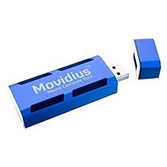
Deep Learning
With Intel Movidius Neural Compute Stick, the aircraft can achieve true deep learning for artificial intelligence. Tiny YOLO, Darkflow and other deep learning methods can be applied to enable the aircraft to learn, evolve, and self optimize for the mission.

